Slide 1
Tompkins County
Criminal Justice Coordination
ANNUAL REPORT
2018-2019
Date: June 2020
Presenter: David M. Sanders Jr.
Criminal Justice Coordinator

Slide 2
Criminal Justice Alternatives to Incarceration
Advisory Board
Function: The Criminal Justice/ Alternatives to Incarceration (CJATI) Advisory Board studies and identifies needs and recommends effective methods for meeting the needs of the County’s criminal justice system. The Board also prepares and supervises the County’s Alternatives to Incarceration Plan.
Purpose:
Study criminal justice system with a focus on Alternatives to Incarceration (ATI)​
Identify unmet needs/ opportunities to meet those needs, improve system​
Make recommendations to County Legislature ​
Provide a forum for networking, coordination, and communication between CBO’s and County Departments that support the Criminal Justice system​
2020 Priorities:
Break the Cycle of Reoffending (Recidivism)
Study the Impact of Bail Reform, identify gaps & ways to fill these gaps
Address the causes of Disproportionate Minority Contact (DMC)
Improve inter-agency communication and collaboration

Slide 3
Criminal Justice Alternatives to Incarceration
Advisory Board
NAME | Department/ Agency/ Organization
Jason Molino | County Administration: designee Lisa Holmes
Hon. Scott Miller | County Court Judge
Hon. Mark Dresser | Town, Village Court Judge Magistrate
Matthew Van Houten | District Attorney
Lance Salisbury | Assigned Counsel Director
Rich John | County Legislator, Chair of Public Safety Committee
Dan Cornell | Director of Probation
Dereck Osborne | Chief Administrative Officer Sheriff: designee Ray Bunce
Mary Orsaio | Rep of local police agencies: IPD Officer
Deborah Dietrich | Rep of CBO with ATI or pre-trial programs Director, OAR
Amy Heffron | System experienced rep
Angela Sullivan | Crime victim rep
Frank Kruppa | Director of community services §41.03 of the Mental Hygiene Law
Eleni Murdough | State-certified substance abuse treatment programs (Cayuga Addiction Recovery Services)
Deana Bodnar | Deputy Commissioner, Department of Social Services
Bridgette Nugent | Deputy Director County Youth Services
Taili Mugambee | At large: Equity & Inclusion Coordinator/ URO Director
Sue Robinson | At larger: retired Probation Officer
Dr. Judy Griffin | At Large: REACH Medical
Louise Miller | Advocacy Center (agency representing Crime Victims)
Suzi Cook | Rep from Co Attorney Office (juvenile justice)
Franci Saunders | Rep agency providing mediation services- CDRC
Chair: David Sanders | Criminal Justice Coordinator, County Administration

Slide 4
COMMUNITY ENGAGEMENT
23%
increase in CJATI attendance from 2018 to 2019
different individuals attended at least one meeting in 2019
Agree/strongly agree: The CJATI Advisory Board is a good forum for networking, coordination, and communication between county departments and local agencies. (survey)
113
100%

Slide 5
TABLE of CONTENTS
01
03
HIGHLIGHTS
CRIME INDEX
ARREST RATES
JAIL CENSUS
JAIL RACE
RECIDIVISM
STRATEGY
DMR
DMR: JUVENILE JUSTICE
DMR: CRIMINAL JUSTICE SYSTEM
SEQUENTIAL INTERCEPT MAPPING
SIM’s: PRIORITIES
TARGETED APPROACH
PROGRAM PERFORMANCE
ALTERNATIVES to INCARCERATION
REENTRY
WELLNESS
DIVERSION
OUTLOOK
GAPS, BARRIERS, & UNMET NEEDS
2020 & BEYOND
FUNDING
UNINTENDED CONSEQUENCES
04
02
05
Notes:
Content

Slide 6
01
HIGHLIGHTS:
CRIME INDEX
ARREST RATES
JAIL CENSUS
RACE AA JAIL
RECIDIVISM
HIGHLIGHTS
FIVE (5) YEAR TRENDS
28%
28%
33%
34%
92%
84%

Slide 7
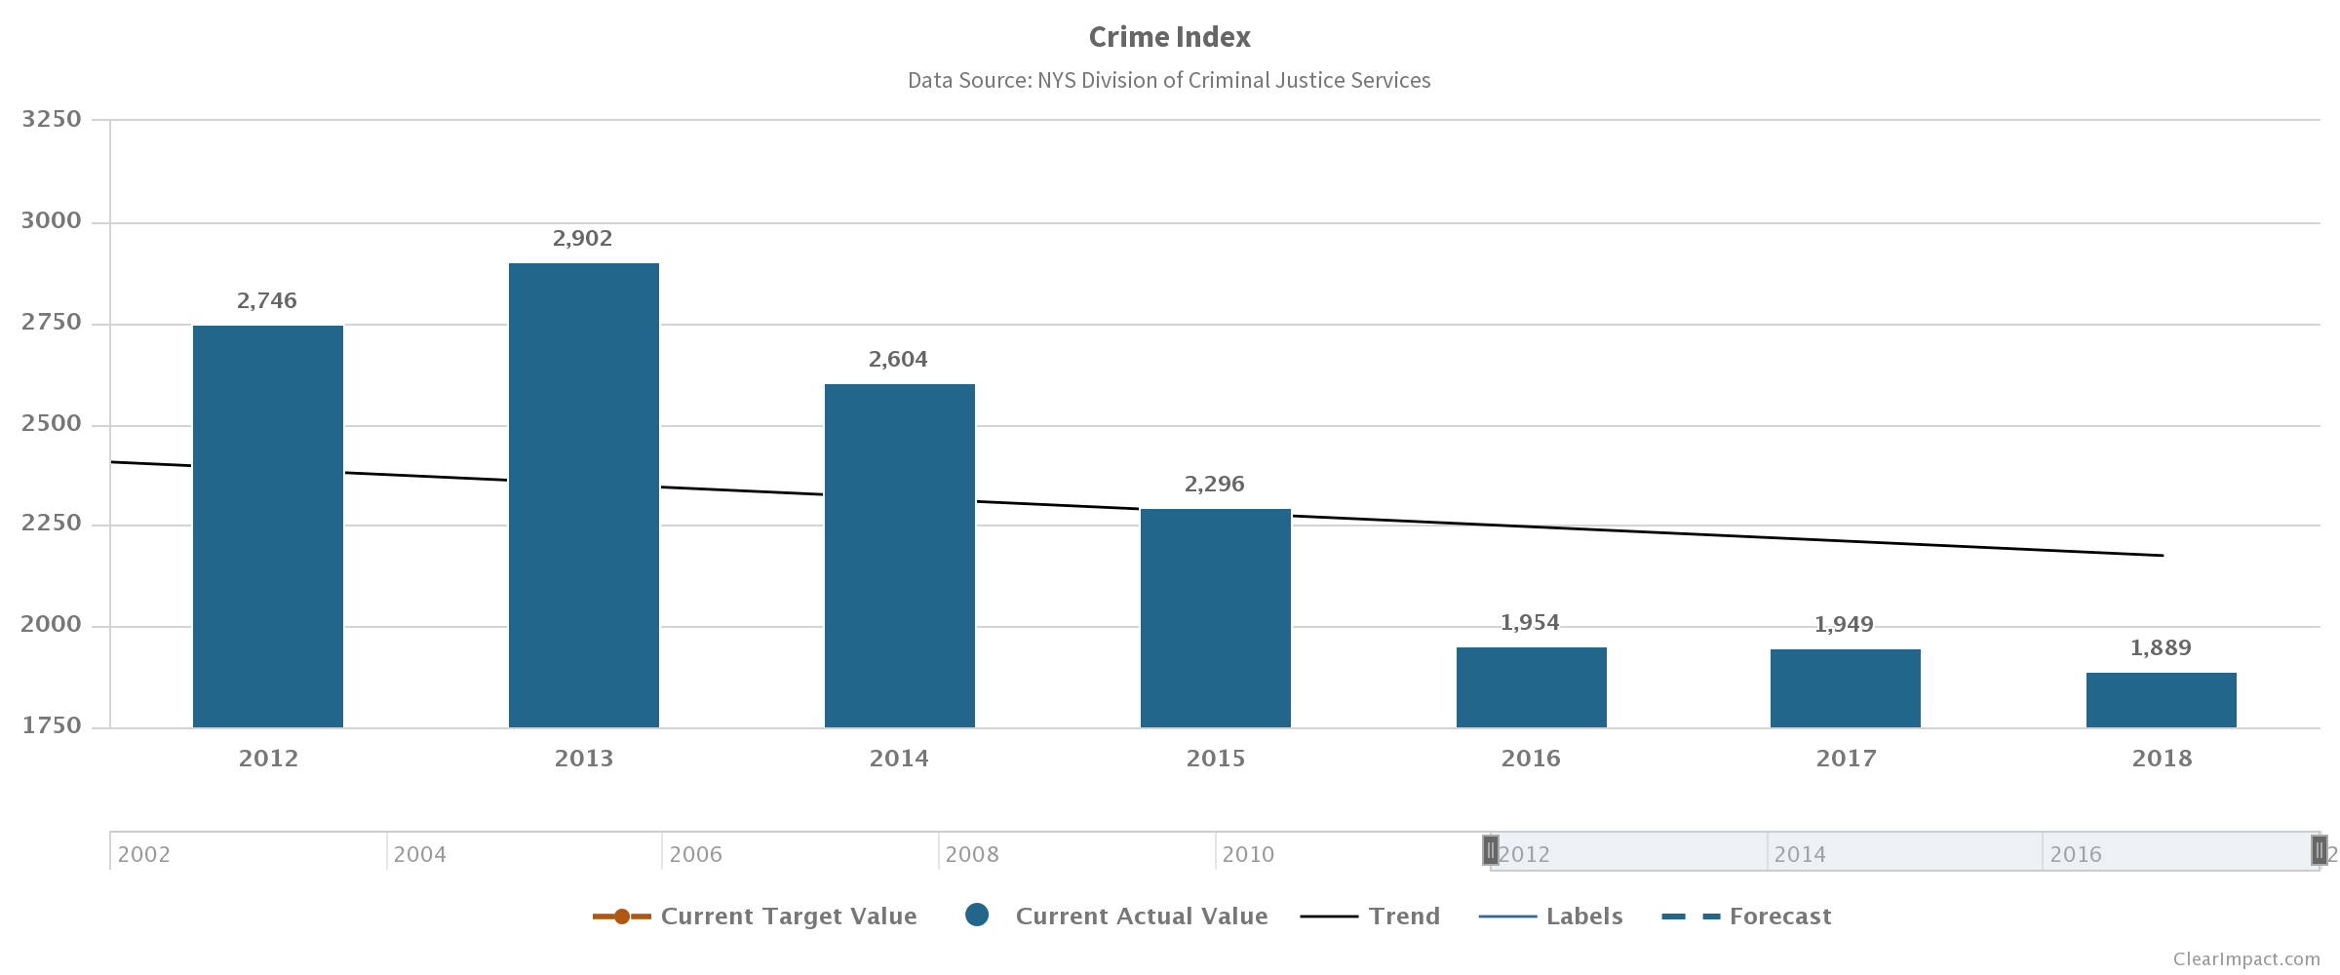
01
HIGHLIGHTS :
CRIME INDEX
ARREST RATES
JAIL CENSUS
JAIL RACE
RECIDIVISM
CRIME INDEX
WHAT DO WE KNOW: Crime Index has decreased for the last SIX (6) years
Crime Index in Tompkins County is slightly higher then counties of similar size
Crime Index is the count of reported crimes
How well Tompkins County reports crimes is not known
Only 1/3 of all crimes are reported. (Vera Institute for Justice)
Public perception and data typically do not align

Slide 8
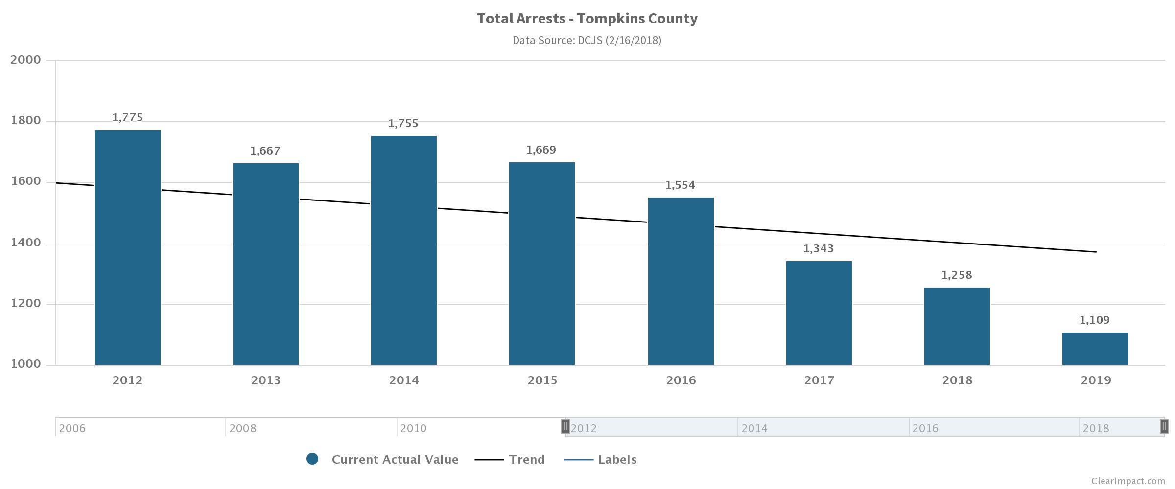
01
HIGHLIGHTS :
CRIME INDEX
ARREST RATES
JAIL CENSUS
JAIL RACE
RECIDIVISM
ARRESTS
WHAT DO WE KNOW:
Arrests have decreased over the last FIVE (5) years
Tompkins County has less arrests than countries of similar size.
Tompkins County is one of only a few Counties with higher crime index than arrests
Deployment patterns, hot spot policing, targeted enforcement, & profiling often contribute to higher arrests
1,109

Slide 9
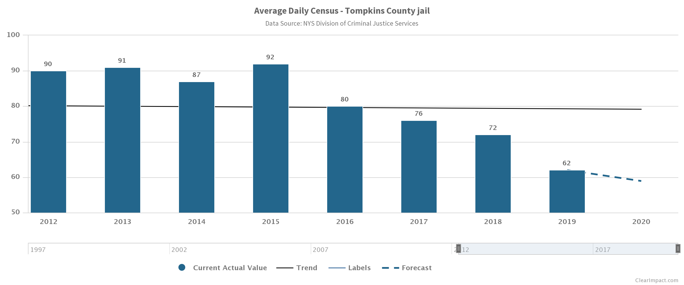
01
HIGHLIGHTS :
CRIME INDEX
ARREST RATES
JAIL CENSUS
JAIL RACE
RECIDIVISM
JAIL CENSUS
WHAT DO WE KNOW:
Jail Census has decreased over the last FIVE (5) years
Tompkins County has and continues to invest in ATI/ Reentry, and many other proactive programs.
Of the CGR Report’s (24) recommendations (18) have been implemented, (5) are in progress, and only (1) has failed to come to fruition. (LEAD)
Judges, DA, and Counsel actively refer to ATI/ Reentry programing.

Slide 10
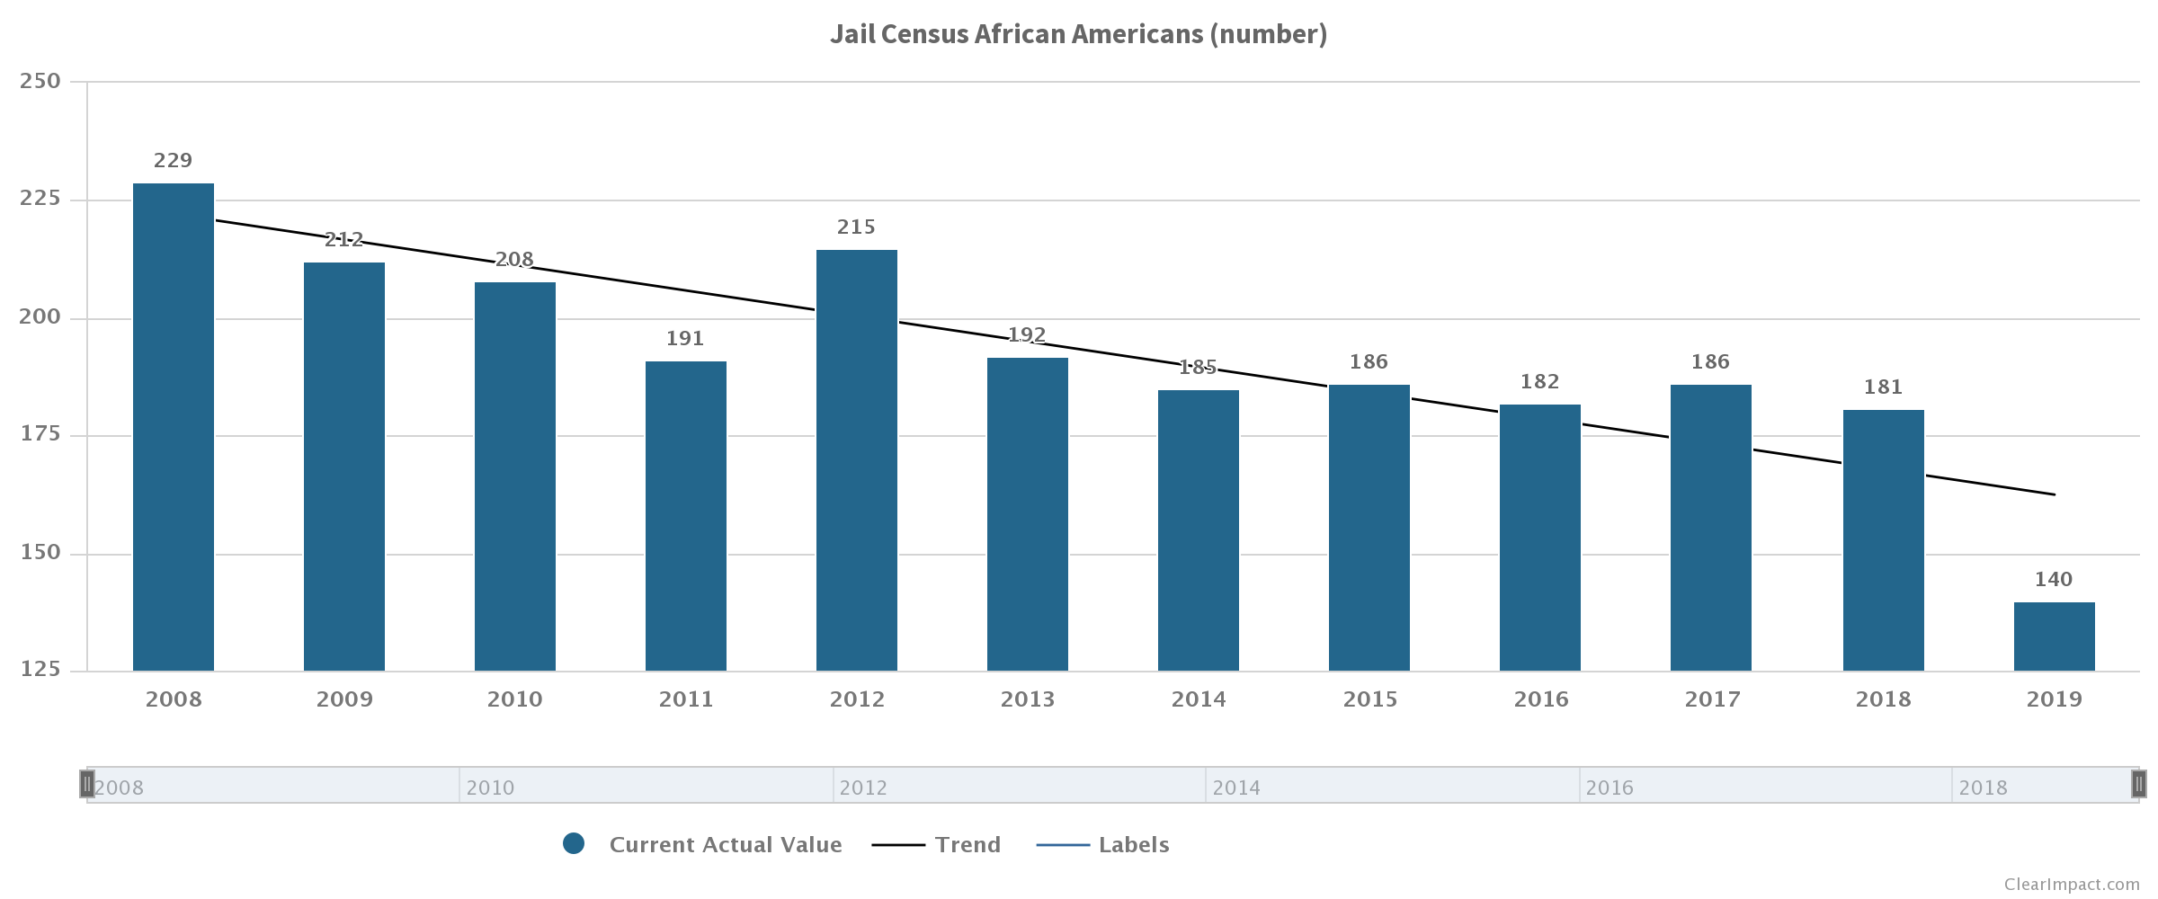
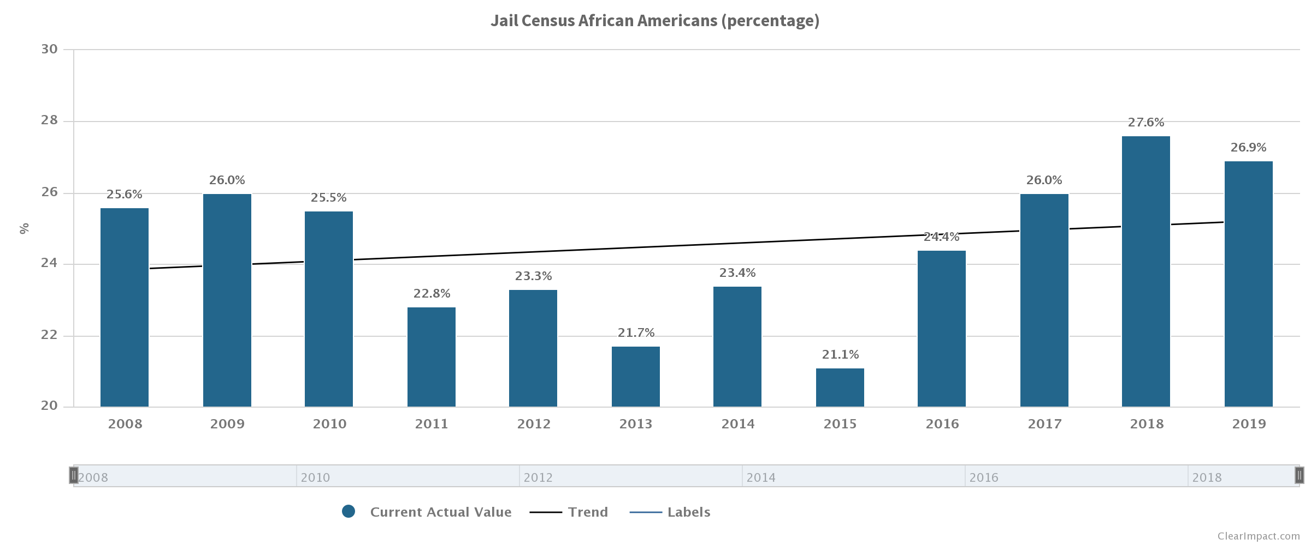
01
Number
HIGHLIGHTS :
CRIME INDEX
ARREST RATES
JAIL CENSUS
JAIL RACE
RECIDIVISM
AFRICAN AMERICAN JAIL CENSUS
WHAT DO WE KNOW:
Disproportionate Monitory Representation is complex, but can be addressed.
Number of AA’s in our Jail has decreased significantly
Percentage of AA continues to climb
Tompkins County is committed to achieving racial equity
Advancing racial equity will require trust, setting goals, measuring outcomes, engaging unlikely partnerships, and reaching out to the community – to start.
Percent

Slide 11
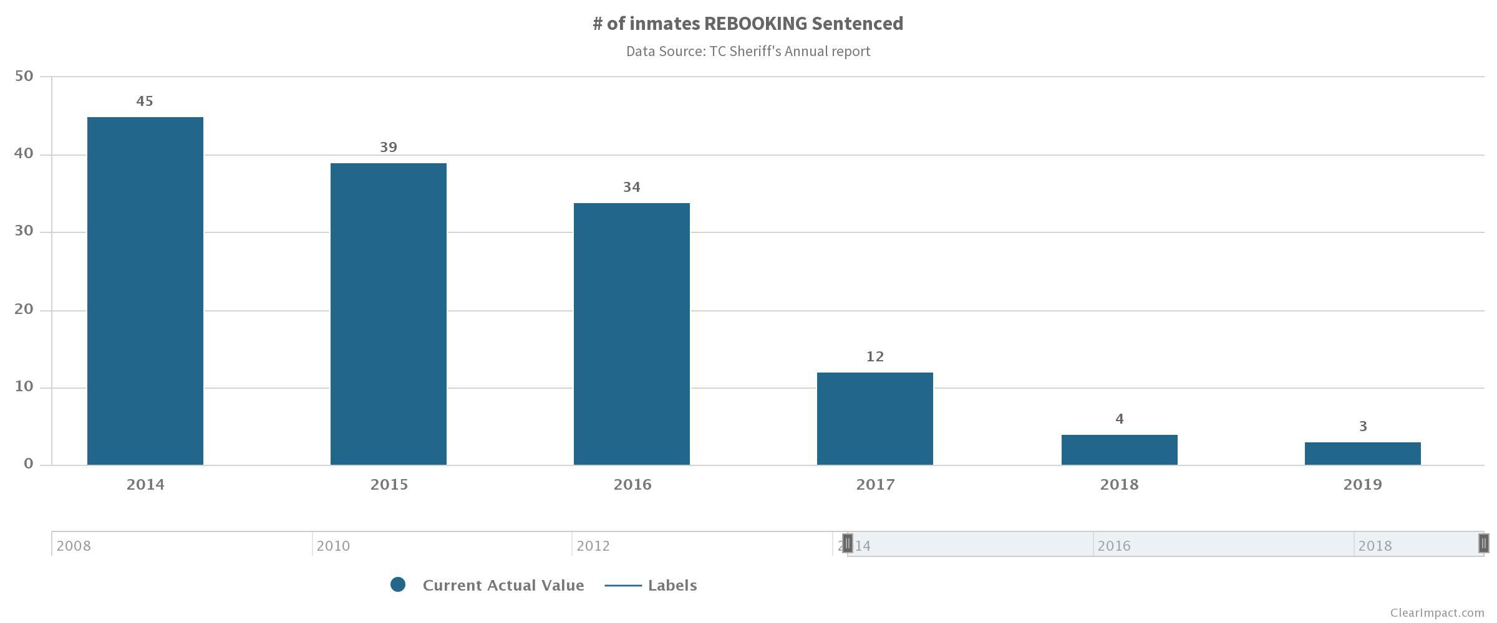
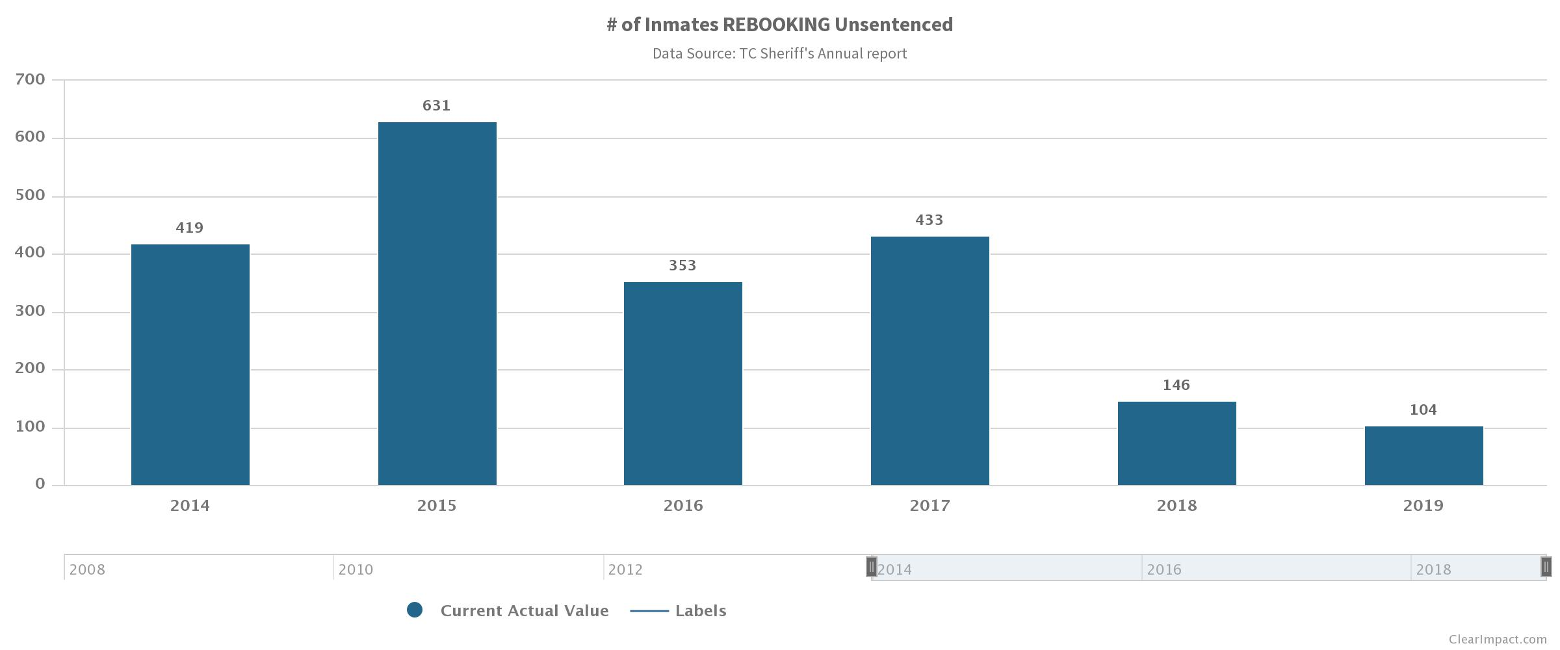
01
HIGHLIGHTS :
CRIME INDEX
ARREST RATES
JAIL CENSUS
JAIL RACE
RECIDIVISM
RECIDIVISM
WHAT DO WE KNOW:
ATI/ Reentry programs are working
Judges/ DA/ Counsel are referring
Client outcomes are being measured
Measurements continue to improve
REACH, CARS, STAP, and ADC have all contributed in reducing recidivism for many struggling with substance use disorder.
SENTENCED
UNSENTENCED

Slide 12
02
STRATEGY
STRATEGY
DMR: Disproportionate Minority Representation
DMR: JUVENILE JUSTICE
DMR: CRIMINAL JUSTICE SYSTEM
SEQUENTIAL INTERCEPT MAPPING
IDENTIFY LOCAL PRIORITIES
TARGETED APPROACH
TARGETED APPROACH
SEQUENTIAL INTERCEPT MAPPING
DMR: JUVENILE JUSTICE
DMR
DMR: CRIMINAL JUSTICE SYSTEM
IDENTIFY & ADDRESS LOCAL GAPS

Slide 13
02
STRATEGY
Disproportionate Minority Representation
Disproportionate Minority Representation
4.4%
% County population African American
Source: Unites States Census Bureau
22.7%
ARREST
% of African Americans Arrested
Source: DCJS 2016/2017/2018 average
26.9%
JAIL
% of Jail Census African Americans
Source: Sheriff’s Annual Report 2019
32.7%
PAROLE VIOLATIONS
% of Parole Violations AA Booked
Source: Raw Data search 2015 Booking

Slide 14
02
STRATEGY
DMR: JUVENILE JUSTICE DMR: CRIMINAL JUSTICE SYSTEM
DMR: Juvenile & Criminal Justice Systems
Juvenile Justice System
Tompkins County
Performance Accountability:
Decision Point(s)
Review current data
Inventory local services
Support Best Practices
TEAM:
REPS Team
CJATI Advisory Board
GOAL: Ensure a Safe, Accountable, Fair, and Effective Juvenile Justice System
Population Accountability:
Root causes of DMR in Tompkins County
Systemic barriers
TEAM:
URO
Researchers from Cornell U
Researchers from Ithaca College
CJATI Advisory Board
GOAL: Eliminate the conditions that contribute to Disproportionate Minority Contact
Reducing Racial and Ethnic Disparities in Juvenile Justice Certificate Georgetown University
NYS Division of Criminal Justice Services
Race Equity Toolkit
Government Alliance on Race & Equity (GARE)
Race Equity and Inclusion Action Guide
The Annie E. Casey Foundation

Slide 15
02
STRATEGY
DMR: JUVENILE JUSTICE
Phase TWO
DSS/Family Court
DMR: Juvenile & Criminal Justice Systems
Hotline Calls
RELEASE
DETENTION
PLACEMENT
REENTRY
Emergency Removals
INTAKE
JUDICIAL
PROCESSING
Termination of
Parental Rights
Initial Contact
& Referral
PROBATION SUPERVISION
ARRESTS
PINS
PINS
SOS
Absences & Truancy
DIVERSION
DIVERSION
DISMISSAL
DIVERSION
DISMISSAL
Special Populations *
Suspensions & Expulsions
Race Equity Plan for Success (REPS)
*Truancy/ Ungovernable/
Runaways/ Curfew/ Underage Drinking
Phase ONE
SCHOOLS

Slide 16
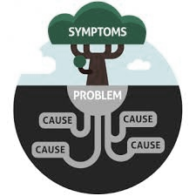
02
POPULATION LEVEL
STRATEGY
Disproportionate Minority Representation Framework
Disproportionate Minority Representation
RESULT: Condition(s) of well-being for ALL people
INDICATORS: A measure that helps quantify the result
ROOT CAUSES:
What actions are we going to implement that address a root cause?
How can we design this strategy so that it addresses a root cause?
Programs | Policies | Functions | Whole Organizations
PERFORMANCE LEVEL
Program A
Program B
Program C
Program D
Program Etc.
Performance Measures:
A measure of how well a program, agency, or policy is working
Quantity | How Much did we do?
Quality | How Well did we do it?
Effect | Is anyone better off? (Client outcomes)

Slide 17
02
STRATEGY
SIM’s PRIORITIES
Sequential Intercept Mapping: Priorities
EXPAND AFFORDABLE HOUSING FOR THE LOWEST INCOME PEOPLE
Development of SRO style properties that are co-located with agencies
40-bed emergency shelter
Having a low-barrier shelter
Family sites
Halfway House
Increase prevention/retention services
Medicaid Funded Assisted Living
INCREASE COMMUNITY OUTREACH WORKER PROGRAM
Inter-agency Outreach Workers – street
Increase COWS based on need
Increase diversity of COWS bases on target locations/ experiences
Evaluate LEAD/COW for duplication
√
IMPROVE INTER-AGENCY COMMUNICATION AND COLLABORATION
Improve information about who is in the jail and when they are released
Develop a protocol for management of inmate information globally
Communication Task Force
Improve Preventative Efforts
√

Slide 18
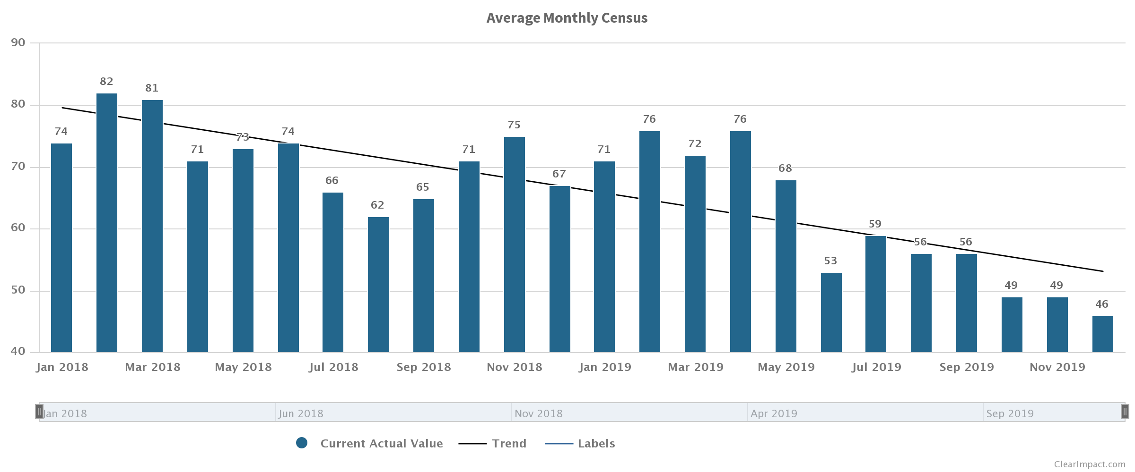
02
Six (6) carefully planned services used to help move a community indicator.
Assigned Counsel: Counsel at First Appearance (defense attorney provided)
Assigned Counsel: Presumed Eligibility (assume client qualifies for services)
District Attorney: Presumption of RoR (Release on Recognizance, when appropriate)
District Attorney: ADA positions (decrease ratio, speed up process, lower unsentenced census)
Judicial: 3rd County Court Judge (decrease wait time and case loads)
County Administration: CJ Coordination (coordination of services, support improved performance)
STRATEGY
TARGETED
Sequential Intercept Mapping: Priorities

Slide 19
03
PROGRAM PERFORMANCE
ALTERNATIVES to INCARCERATION Programs
REENTRY Programs
WELLNESS Programs
DIVERSION Program
Program Performance

Slide 20
03
PROGRAM PERFORMANCE
ALTERNATIVES to INCARCERATION Programs
REENTRY Programs
WELLNESS Programs
DIVERSION Program
Program Performance
375
ALTERNATIVE to INCARCERATION (8): are types of supervision other than jail that can be given to a person who commits a crime.
354
REENTRY Program (7): are designed to assist incarcerated individuals with successful transition back into the community after release.
1,155
WELLNESS/ SUPPORTIVE Services (5): in our jail and the community, providing a number of services for people dealing with mental health, substance use, and other health challenges.
154
ASSISTED DIVERSION Programs (2): Community developed program to assist in low level interventions.

Slide 21
03
PROGRAM PERFORMANCE
ALTERNATIVES to INCARCERATION
REENTRY
WELLNESS
DIVERSION
Program Performance: ATI
ALTERNATIVE to INCARCERATION
Probation: Day Reporting
Probation: Electronic Monitoring
Probation: Service Work Alternative Program (SWAP)
Probation: Greatest Risk Supervision
Court: Felony Drug Treatment Court (FDTC)
Court: Ithacan Community Treatment Court (ICTC)
Court: Ithaca Wellness and Recovery Court (IWRC)
OAR: Bail Fund (provides Bail to people who can’t afford it.)
HOW MUCH
375 clients (2018)
HOW WELL
122 successful outcomes
BETTER OFF
4,800 Jail days avoided

Slide 22
03
PROGRAM PERFORMANCE
ALTERNATIVES to INCARCERATION
REENTRY
WELLNESS
DIVERSION
Program Performance: REENTRY
Female
REENTRY Program
Mental Health: Reentry Program
OAR: Parole Transition
OAR: Housing Services
OAR: Endeavor House
OAR: Case Manager Endeavor House *
OAR: College Initiative Upstate
URO: Ban the Box Job Fair * Numbers only
Male
Other
2 more
HOW MUCH
354 clients
White
HOW WELL
1,681 successful outcomes
Black
BETTER OFF
26% Recidivism Rate (81/309)
* Indicates no performance measures

Slide 23
03
PROGRAM PERFORMANCE
Program Performance: WELLNESS & DIVERSION
WELLNESS/ SUPPORTIVE Services:
Sheriff Corrections: Forensics Counselor
Sheriff Corrections: Second Nurse
Sheriff Corrections: BOCES*
Sheriff Corrections: Vivitrol*
Mental Health Association: Wellness Recovery Action Plan*
ASSISTED DIVERSION Programs:
F&CS : Community Outreach Worker Program
Mental Health: Mobile Crisis Intervention Services*
HOW MUCH
1,155 Intakes (2018)
154 clients (2019)
1,166 Sick calls
2,308 Encounters
HOW WELL
397 Specialized referrals*
66% Basic needs met
54% Accepted feedback
BETTER OFF
301 PHQ-9 Assessments**
96% Successful referrals
*Specialized Referrals: Lab, Radiology, Dental, Physician
**PHQ-9 (Patient Health Questionnaire–9) Evidence Based Assessment
* Indicates no performance measures

Slide 24
04
Performance: REENTRY
OUTLOOK
GAPS
BARRIERS
UNMET NEEDS

Slide 25
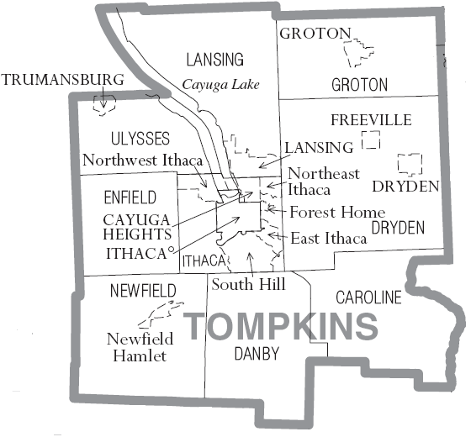
04
HEALTHCARE:
HEALTHCARE:
Behavioral healthcare for homeless (REACH as stepped up)
Generally no available psychiatric beds.
MAT services and regulations are limited.
Emergency Department can only provide up to (3) doses
Insufficient number of prescribing physicians
LAW ENFORCEMENT & FIRST RESPONDERS:
LAW ENFORCEMENT & FIRST RESPONDERS:
No Crisis Intervention Team (CIT)-trained officers in the smaller law enforcement depts.
The absence of a state standard mandating
3. Law enforcement officers must contend with long wait times during hospital drop-offs.
4. The sharing of information between dispatchers and responding law enforcement officers is incomplete.
OUTLOOK
GAPS, BARRIERS &
UNMET NEEDS
Performance: REENTRY
HOUSING
HOUSING:
HOUSING:
1. Safe and drug-free housing, particularly for persons newly released from incarceration, is in great need.
2. It was observed by several participants that the DSS interpretation/implementation of “homelessness” varies by county and can result in adverse outcomes for persons who are not recognized as meeting the threshold of homelessness for receipt of public benefits.
SUBSTANCE USE
TRANSPORATION
EMPLOYMENT
MENTAL HEALTH
PEER SUPPORT:
PEER SUPPORT:
Persons with lived experience are not well integrated into behavioral health services in residential or community settings.
COLLECTION & SHARING DATA:
Create and promote a continuum of care across various systems. Available data is not easily accessible and are not regularly shared with behavioral health and criminal justice stakeholders.
COORDINATION
COLLECTION & SHARING DATA:
CRISIS SERVICES:
DIVERSION
CRISIS SERVICES:
1. Crisis lines are not available 24/7, and are not well coordinated.
2. The Mobile Crisis Team lacks financial and human resources.

Slide 26
05
2020 & BEYOND
FUNDING
UNINTENDED CONSEQUENCES
2020 & BEYOND
Notes:
Tough decisions must be made in 2020, but what are the consequences?

Slide 27
05
Tompkins County (ATI) Alternatives to Incarceration funding
2020 & BEYOND
Department | Description | Expense | Recommended
Co Adm | Criminal Justice Coord. (3-year multi‐year 2018-2020) | $68,464 ($136,929) | One-time
Contingent | Sequential Intercept Mapping Project | $22,000 | (Federal grant)
* | Georgetown University RRED certification | $38,000 | (State grant)
Probation | Sr. Probation Officer for Drug Court/ EM |  | Target
Sheriff Corrections | Second Jail Nurse Forensics Counselor |  | Target Target
Mental Health | Reentry Coordinator |  | Target
Mental Health | Wellness Court Coordinator | $43,456 | One-time
OAR | College Initiative Upstate | $110,000 | One-time
OAR | Parolee/ Housing Case Manager | $50,000 | One-time
OAR | Case Manager Endeavor House | $18,000 | One-time
District Attn | ADA position |  | Target
F&CS | Community Outreach Worker | $40,000 | One-time
FUNDING
Law Enforcement Assisted Diversion ( LEAD) $25,000 One-time
Notes:
$354,920 funding ($60,000) grants 2019/ for the most part County Dept. (are now Targeted) while CBO’s continue to be One-Time

Slide 28
05
UNINTENDED CONSEQUENCES
Probation: Greatest Risk Supervision
2020 & BEYOND
F&CS : Community Outreach Worker Program
Probation: Day Reporting
OAR: Case Manager Endeavor House
DIVERSION
COORDINATION
OAR: Housing Services
URO: Ban the Box Job Fair
TRANSPORTATION
OAR: Bail Fund
HOUSING
MH: Reentry Program
OAR: College Initiative Upstate
Probation: Electronic Monitoring
OAR: Parole Transition
Mobile Crisis Intervention Services
SUBSTANCE USE
EMPLOYMENT
Court: Felony Drug Treatment Court (FDTC)
Court: Ithacan Community Treatment Court (ICTC)
MENTAL HEALTH
OAR: Endeavor House
Probation: Service Work Alternative Program (SWAP)
Court: Ithaca Wellness and Recovery Court (IWRC)
Notes:
What are the costs and consequences of cutting programs? How can we regain “TRUST” of vulnerable populations if programs are cut?

Slide 29
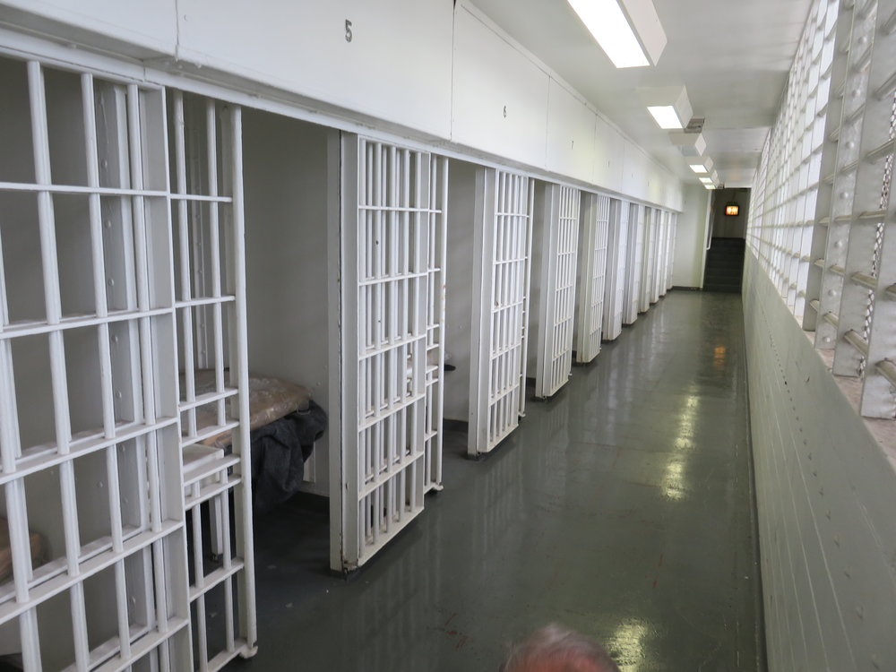
01
HIGHLIGHTS
CRIME INDEX
ARREST RATES
JAIL CENSUS
JAIL RACE
RECIDIVISM
03
PROGRAM PERFORMANCE
ALTERNATIVES to INCARCERATION
REENTRY
WELLNESS
DIVERSION
02
STRATEGY
DMR
DMR: JUVENILE JUSTICE
DMR: CRIMINAL JUSTICE SYSTEM
SEQUENTIAL INTERCEPT MAPPING
SIM’s: PRIORITIES TARGETED APPROACH
04
OUTLOOK
GAPS, BARRIERS, & UNMET NEEDS
05
2020 & BEYOND
FUNDING
UNINTENDED CONSEQUENCES

